Slide 1
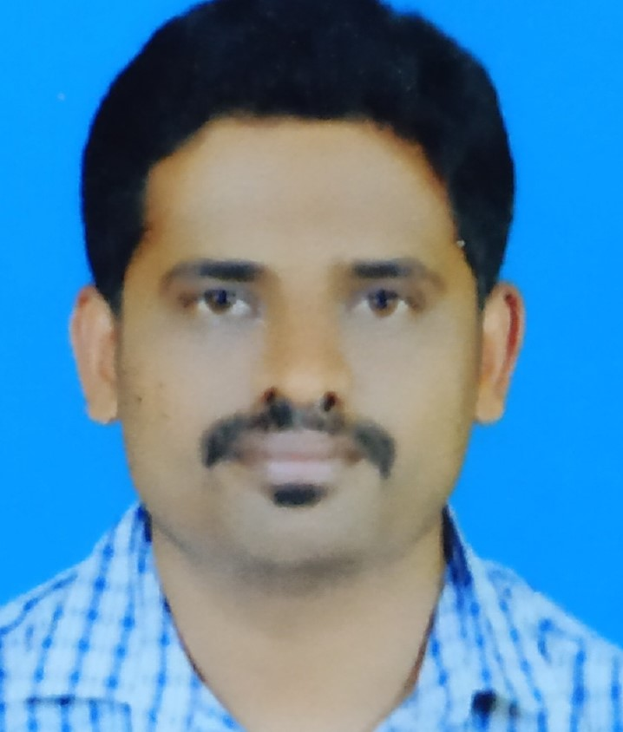
Functional/ technical skills
Cloud Services :AWS:IAM,S3,VPC,IAM,Application Load Balancer.EKS.
Worked on shell script to automate the tasks
Worked On Kubernetes for managing the containers at production level, Written YAML files for the deployment and services. Created an ingress gateway to route the traffic to virtual service which inturn route to the services in the kubernetes cluster.
Tools:Docker,Kubernetes,Terraform,Aws,Jenkis,Git,Bitbucket,Linux.
Language skills
English
Chethan G D
DevOps Engineer | chethan.g.d@accenture.com
Project experience
Project Name: Alcyon(oct 2022 to march 2024)
Alcyon is a product, It’s a toll management system where incident data are captured using an camera.
Worked on technology. Ex: Docker, Kubernetes
Deploying the application using helm chart
Worked on releasing the microservice version using a helm chart.
Worked on creating an infrastructure using a terraform like EC2,VPC,IAM. ALB,S3.
Project Name: TeqoOS(April 2021 to Sept 2022)
TeqoOS is a renewable assets computerized maintenance management software.
Automated CI process using Jenkins.
Installed Jenkins, created jobs for builds, deployment and another task to automate.
Worked on checkmarx for security vulnerabilities.
Installed hashicorp vault CSI driver on Kubernetes.
Project Name: Solar pulse(June 2018 to March 2021)
solarPulse is a cloud-based solar monitoring application speciall designed for solar rooftop asset owners, managers & operators to manage plant performance on a real-time basis.
Created AWS EC2 instances and setup to AWS cloud.
Worked on creating S3 bucket attached volume to running instance.
Worked on IAM service and creating VPCs.
Professional background
5+ Years of experience in Devops engineer as a Kubernetes Enginners, and worked as a Infrastructure Engineer using Terraform to automate the aws services.
1
*

